Slide 1
New Features in the Bluetooth Core Specification v1.2
Faster connection
Adaptive frequency hopping
Extended SCO links
Enhance QoS

Slide 2
1. Faster Connection
In v1.1, the inquiry/page scan hopping sequence is determined by a function called [Xir4-0].
v1.2 adds a new interlaced scan for slaves:
  Every odd hop uses the original definition in v1.1.
  Every even hop uses frequency [Xir4-0 + 16] mod 32.
  Master’s inquiry is unchanged.
If (scan interval) < 2*(scan window), then interlaced scan should not be used.
The result is a speedup in inquiry and page procedures.

Slide 3
Interlaced Scan Sequence of Slaves
original
  (AA…A)(BB…B) …
New
  switch even A’s with even B’s
  (ABAB…AB)(BABA…BA) …

Slide 4
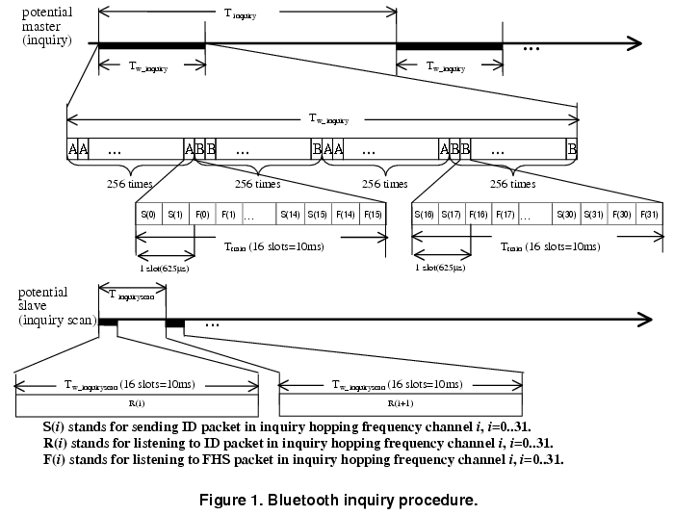
Inquiry and Inquiry Scan

Slide 5
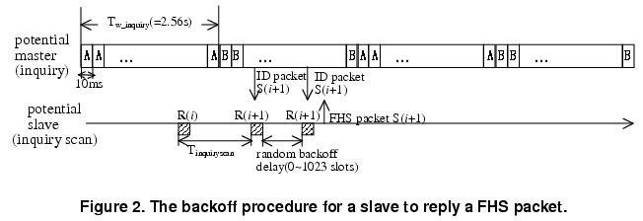
Backoff Procedure

Slide 6
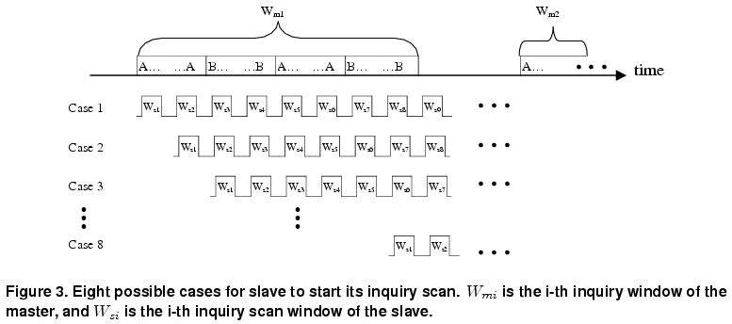
8 Possible Timing for Matching
(original version)

Slide 7
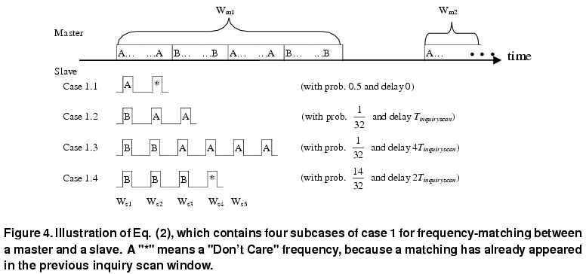
4 Subcases of Case 1 in Fig 3
(original version)

Slide 8
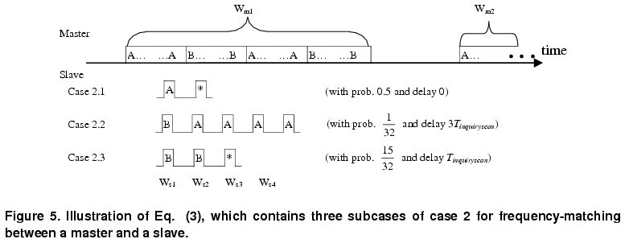
3 Subcases of Case 2 in Fig 3
(original version)

Slide 9
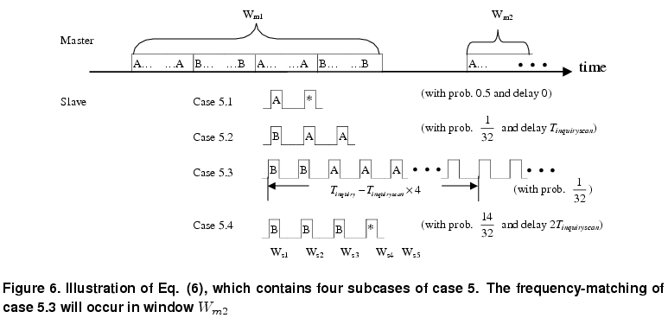
4 Subcases of Case 5 in Fig 3
(original version)

Slide 10
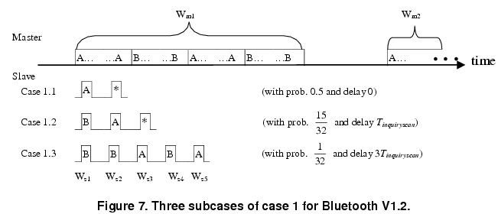
3 Subcases of Case 1
(new V1.2)

Slide 11
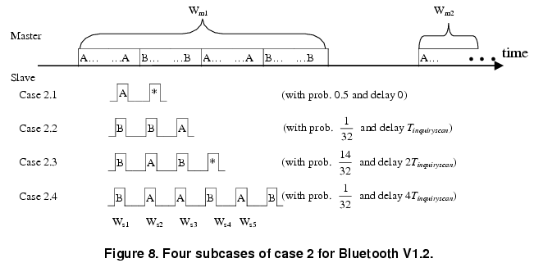
4 Subcases of Case 2
(new V1.2)

Slide 12
2. Adaptive Frequency Hopping (AFH)
AFH is used to improve the performance of physical links in the presence of interference from other devices in the ISM band.
Basic idea: mask the bad channels.

Slide 13
AFH (cont.)
Only the master can enable/disable AFH.
A master may request channel classification information from the slaves.
  Then the master classifies channels into used (interferred) and unused (un-interfered).
    How to make the decision is not specified in the spec.
  The used/unused channels are used by all devices in the same piconet.
When an used frequency is selected, a Channel re-mapping function will re-map the used channel to a unused channel pseudo-randomly.

Slide 14
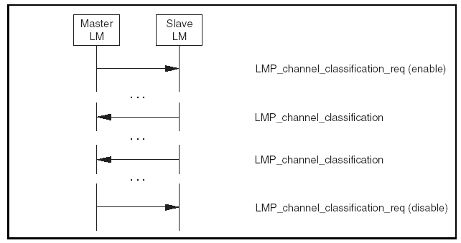
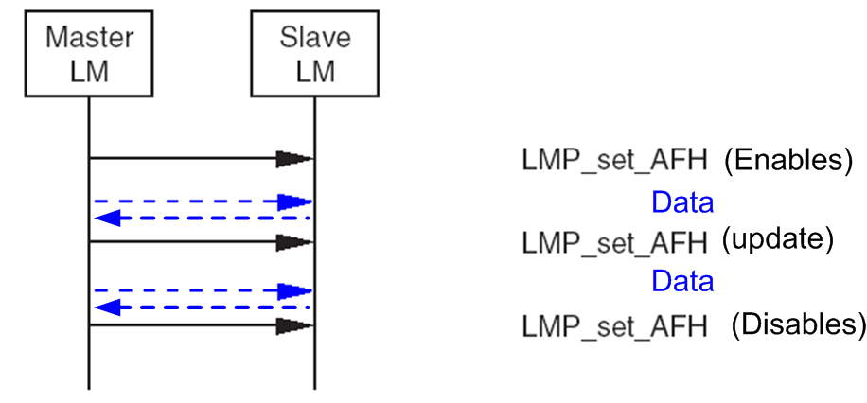
Channel Classification Steps
The master first collects channel classifications from slaves (LMP_chennel_classification).
Then the master announce its decision (LMP_set_AFH).

Slide 15
3. Extended SCO links (eSCO)
eSCO is designed to complement the error transmission in SCO (which will not be retransmitted in v1.1).
  The eSCO is established by sending an eSCO setup message via LMP.
  The parameters of eSCO setup message include time interval, transmission window size, and re-transmission window size.
  (refer to Fig. in the next page)
polling rules in eSCO:
  The eSCO reserved slots are used the same as the original SCO.
  The retransmission windows can be used for SCO retransmission (if there is error in the previous SCO transmission); otherwise, these slots can be used by typical ACL traffic.

Slide 16
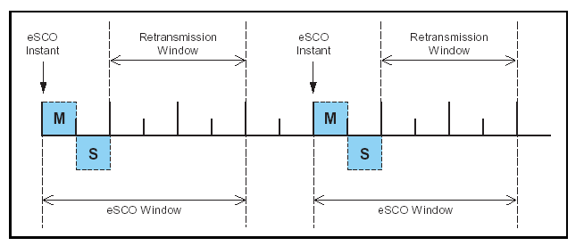
eSCO Link

Slide 17
4. Enhance QoS
Enhanced error detection and flow control
Enhanced synchronization capability
Enhanced flow specification (option)
** Note: a lot of details are omitted here.

